Slide 1
Secure Your ASP.NET WebApi and MVC Applications
Bob Walker
Lead Application Developer - Farm Credit Services of America

Slide 2

About
Developer since 2004
Lead Application Developer for Farm Credit Services of America
Previously worked for TelventDTN (later Schneider Electric), West Corporation, and Sandhills Publishing
Married in 2015
Passions: Software Development, Cycling, Photography
Founder: CodeAperture.io

Slide 3

Farm Credit Services of America
Association in Farm Credit System which started in 1916
Lending institution providing credit to 1/3 of rural America
Types of loans
Budget
Line of Credit
Real Estate
Country Home Loan
My Team is responsible for one of the loan origination systems

Slide 4
Farm Credit is a Target for

Slide 5
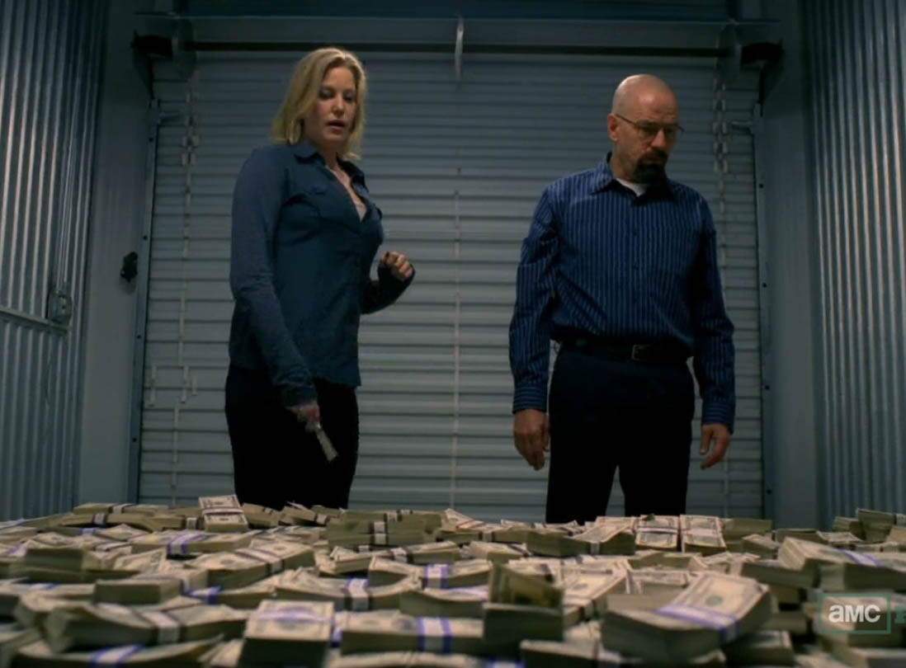
Cash Money

Slide 6
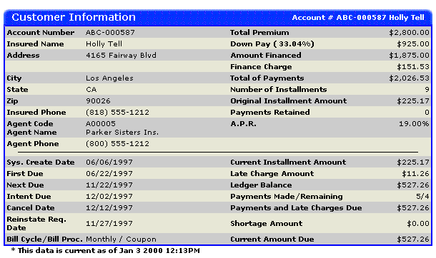
Customer Information

Slide 7
100% Security is Impossible

Slide 8
We Exist to Serve…

Slide 9


Slide 10
Have realistic security expectations

Slide 11


Slide 12
But…we shouldn’t trust our users (even employees)

Slide 13
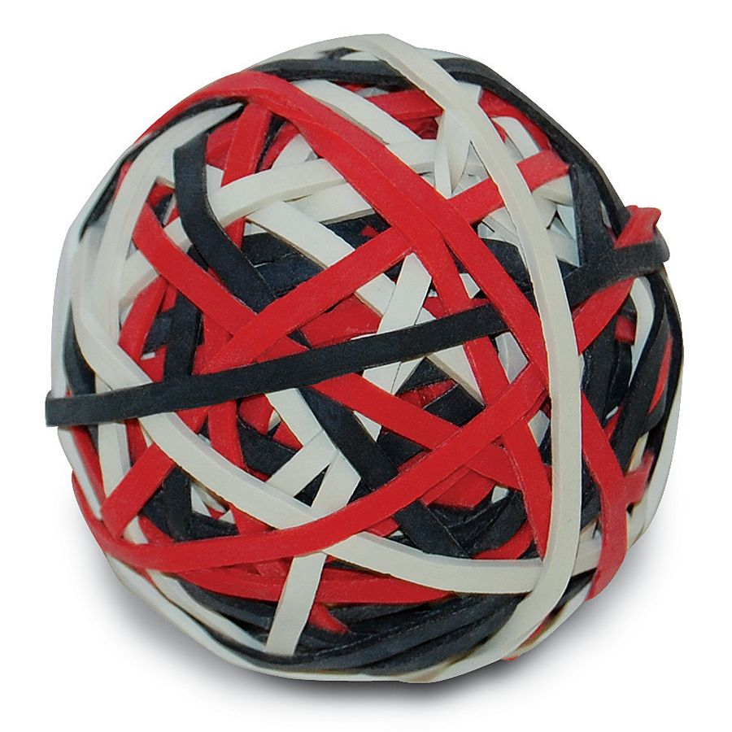
Employees can do dumb things

Slide 14
There is a struggle between usability and security

Slide 15
A Realistic Approach to Security…

Slide 16

Layers Of Security
Authentication
Authorization
Data Validation
Content Filters
Action Filters
Encryption
Hashing
Code Reviews
White-Hat Hacking
Code Analysis

Slide 17
Best Approach to Start With

Slide 18
Appling Changes Globally

Slide 19
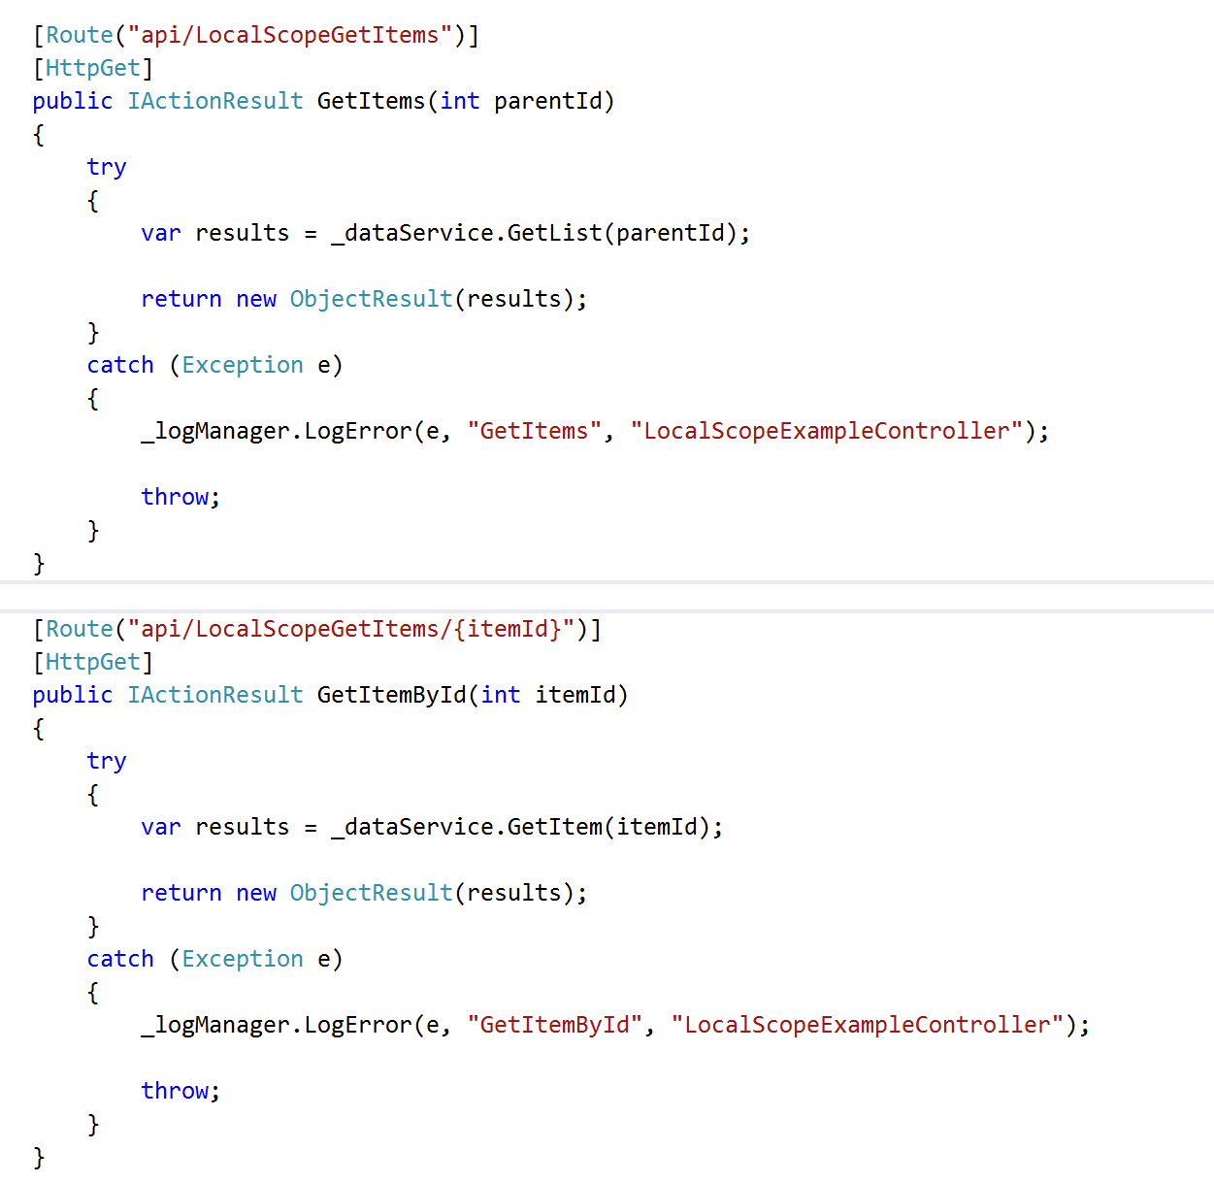

Slide 20
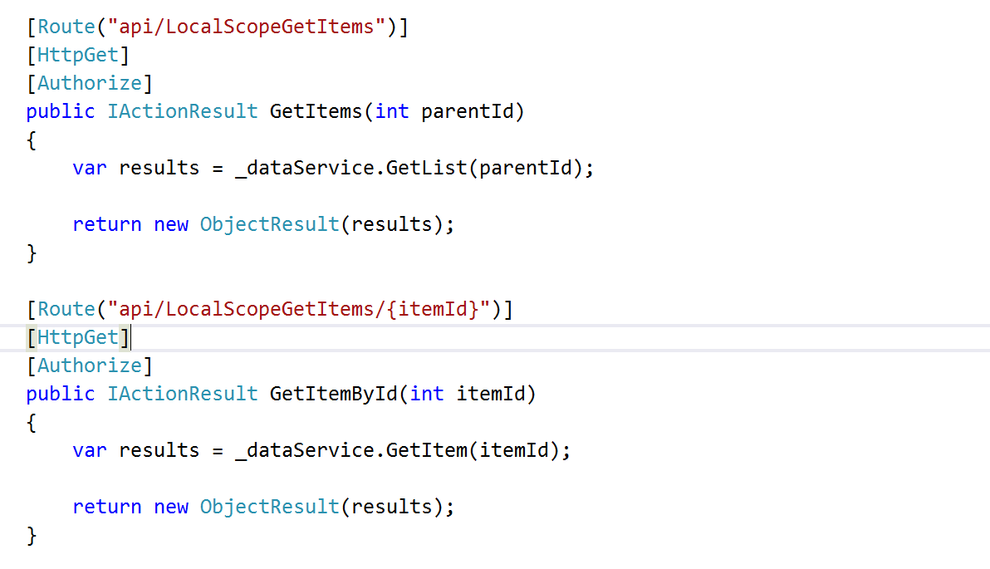

Slide 21
Object Level Security Problems
Developers will forget (we’re human!)
Inconsistency
More code to maintain
Duplicated code

Slide 22
It’s Mathematics
20 WebApi Controllers
x 4 Method Per Controller (CRUD)
= 100 Attributes
50 WebApi Controllers
x 4 Method Per Controller (CRUD)
= 200 Attributes

Slide 23
Application Level Security

Slide 24
Application Level Security Settings
Web.config / App.config
Global.asax
Exception Filters
Action Filters
DbContext (if using Entity Framework)

Slide 25
Configuration Changes

Slide 26
Content Security Policy

Slide 27
Cross-Site Scripting (XSS)
JavaScript is injected into a system
Persistent
Non-Persistent (reflective)
Downloads malicious payload
Sends cookie information (session hijacking)
Keystroke logger
Viruses

Slide 28
Content Security Policy
Response Headers
Whitelist of acceptable sources / Blacklist of unacceptable sources
Types
JavaScript
Images
CSS
Websocket
Disables inline CSS, eval function, setTimeout, setInterval, DOM event handlers
Configured in web.config

Slide 29
Content Security Policy Demo

Slide 30
Content Security Policy Rules Of Thumb
Blacklist everything
Whitelist only accepted sources
Test, test, test
Don’t blindly add

Slide 31
Cookie Policies

Slide 32
Session Hijacking
An Attacker using XSS is able to hijack session cookies
Attackers go after
E-Commerce Sites (Amazon, NewEgg, etc.)
Banking
Email

Slide 33
Cookie Policy
HttpOnlyCookies - Any cookie sent from the server cannot be accessed via JavaScript
RequireSSL – Cookies are only sent when accessing SSL side
Configured in web.config

Slide 34
Cookie Policy Demo

Slide 35
Exception Filter

Slide 36
Exceptions are major security risk
Same information to debug problems is used by attackers
SQL Exception
Query Ran
Column Name
Table Names
Exception on REST calls
End Point Hit
Parameters
Headers

Slide 37
Exception Filter
Handles all errors thrown
Logs Error Details for development team
Only Exposes Minimum Information to user
Configured global in the Global.asax file

Slide 38
Exception Filter Demo

Slide 39
Action Filters

Slide 40
Action Filters
Custom Business Logic to enforce security
Can run before or after request is complete
All Action Filters must run before controller method is run
Able to access dependency injector
Configured globally through Global.asax

Slide 41
Loan Application Action Filter
Loan Cannot Be Edited When
It is in “completed” state
Opened by another user
User is viewing in read-only mode
Throw Exception when user attempts to edit
Be sure to log exception (for auditing!)

Slide 42
Action Filter Demo

Slide 43
Database Protection

Slide 44
Configuration
Don’t store username/password in web.config
Don’t grant rights to built in roles for application service account
Grant permissions at schema level
Grant select to dbo
Grant CRUD to custom schema
Use different service accounts per application

Slide 45
Entity Framework
Create context to inherit from dbcontext
Inject custom rules on save changes method

Slide 46
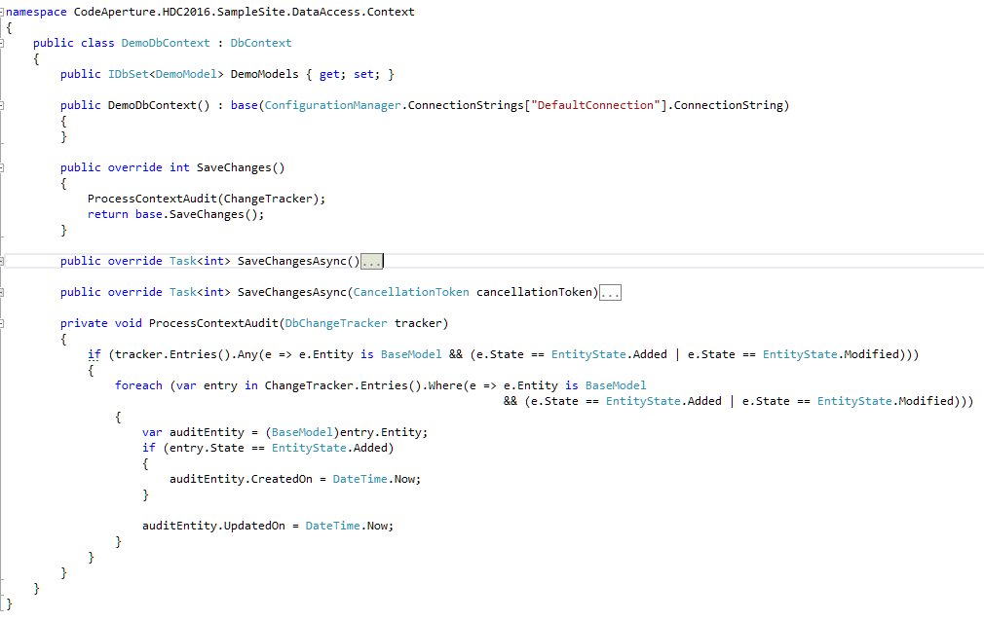

Slide 47
SDLC Improvements

Slide 48
Automated Testing
Security Exploits are often times nothing more than a missing test case
Unit Tests
Service Tests
UI Tests

Slide 49
White-Hat Hacking
Have other developers try to hack your site
Be as evil as you can be
Get permission first!

Slide 50
Code Reviews
Evaluate for possible security flaws
SQL Injection (dynamic SQL)
XSS (reflective and persistent)
Security disabled to support business needs
Object Level Security (try/catch blocks, attributes, etc.)

Slide 51
Create Intrusion Detection Plan

Slide 52
Example Parts of Plan
Intrusion detection
Automated
Manual
Logging
Response
Data Cleanup
Customer Notification
Post Moterm

Slide 53
Don’t Start Plan After Your Compromised

Slide 54


Slide 55
Not all doom and gloom

Slide 56


Slide 57
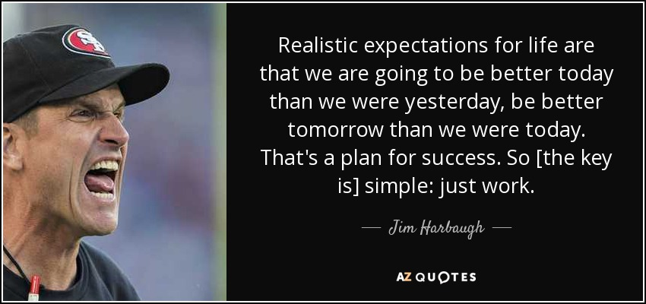

Slide 58
Questions?

Slide 59
Thank you!
Follow @CodeApertureIO
Email: bob.walker@codeaperture.io
Download: https://github.com/CodeAperture/HDC2016

